Slide 1
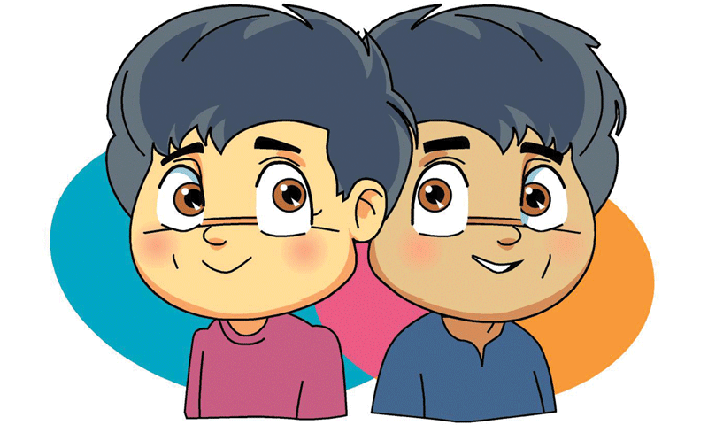
Doppelganger Cartoon
Supervisors
Dr. Asitha Bandaranayake
Mr. Sampath Deegalla
Mr. Ishan Gammanpila
Group Members
E/15/065 De Silva K.G.P.M.
E/15/076 Dileka J.H.S.
E/15/220 Maliththa K.H.H.

Slide 2
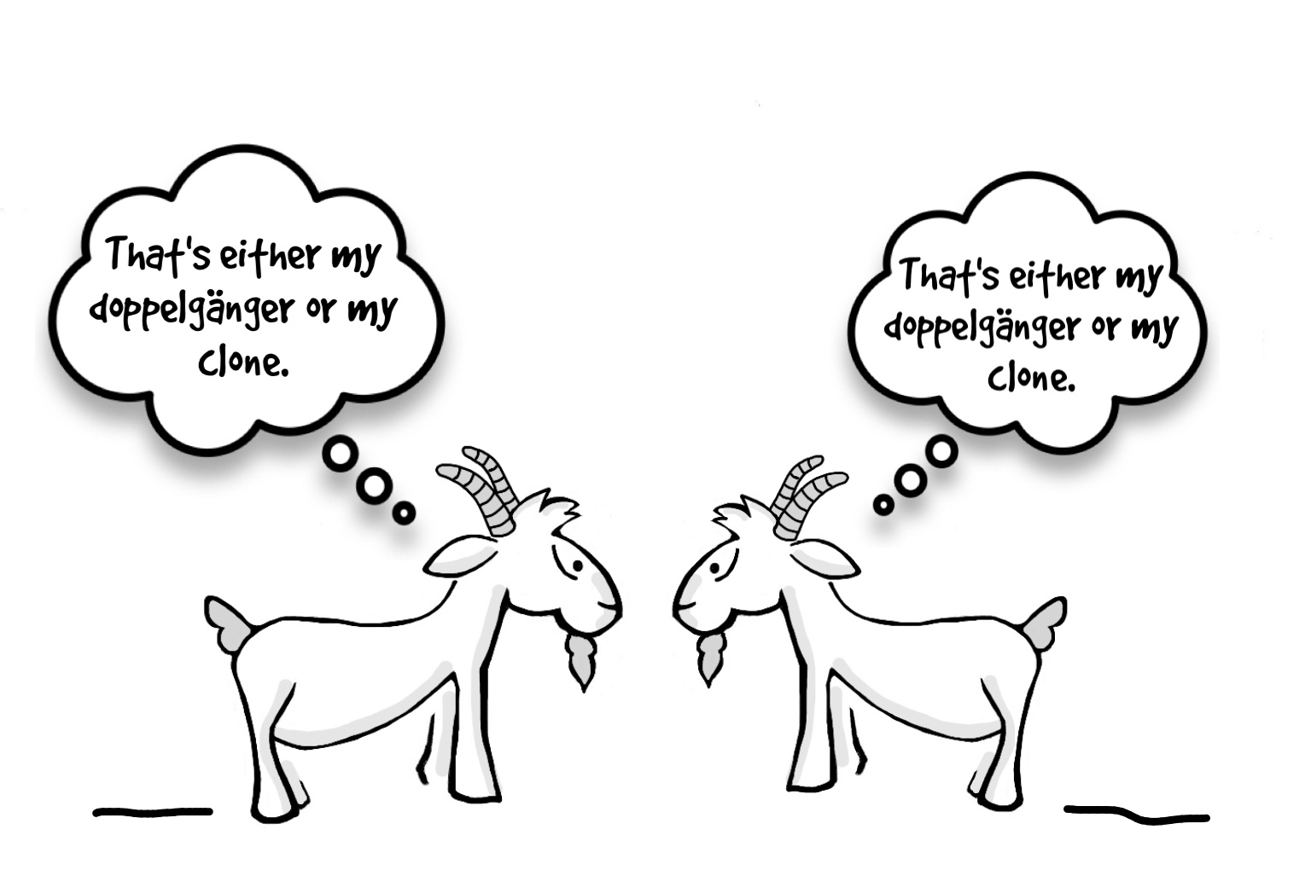
Doppelganger ?
Someone’s twin, or double
Look-alike another with the more common features
German word - "double walker" or "double goer".
“Apparently, there is a one in 135 chance that there’s a single pair of complete doppelgängers.”
- University of Adelaide biologist Teghan Lucas and team-

Slide 3
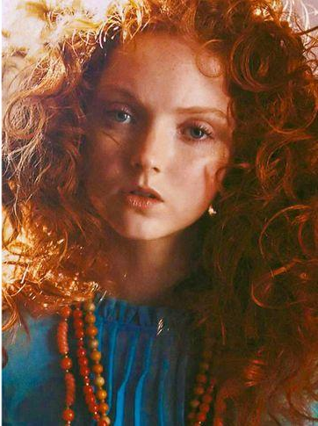

Problem Definition
Twin-stranger , Celebrity look-alike
Interest of check and contrast themselves with cartoons
Doppelganger cartoon - a funny , attractive, and intriguing topic
How do you find your doppelganger cartoon?

Slide 4

Aim
Create a machine learning algorithm that can find the cartoon character that best looks like the uploaded photo

Slide 5
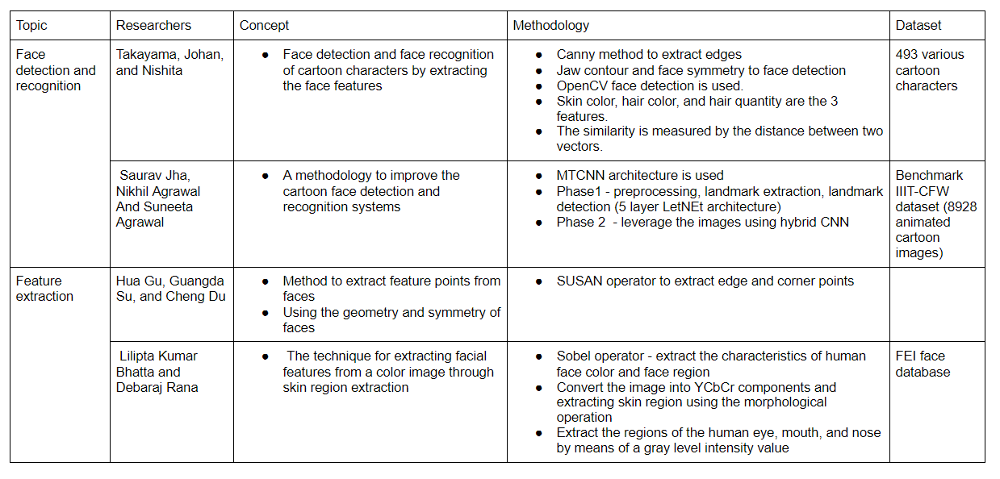
Related Works

Slide 6
Solution
Get the input image through web application
Interaction of users
Can share on social media
Data augmentation & data preprocessing
Face detection & Feature extraction using pretrained models
Training a model from scratch
very expensive
requires huge data sets to achieve good generalization performance
requires high computational power
Store features of cartoon images in csv format
Compare similarity between two feature vector using distance metrics
Euclidean
Manhattan

Slide 7
Related Works & Solution
Similarities:
Use CNN based model for feature extraction & face detection
Use image augmentation techniques for comparing images
Use transfer learning methods
Differences:
Build an algorithm for selecting a best-matching cartoon image
Create user interfaces for getting images and displaying results
Notes:
Me related works tikak gnath danna weida?
Ow ned

Slide 8
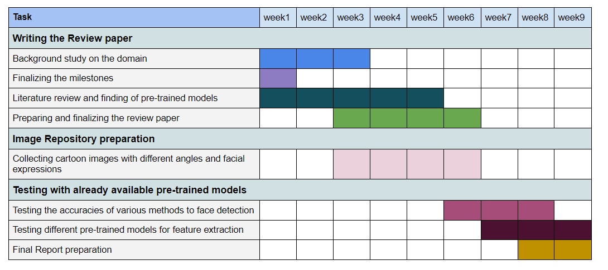
Gantt Chart (Phase 1)

Slide 9
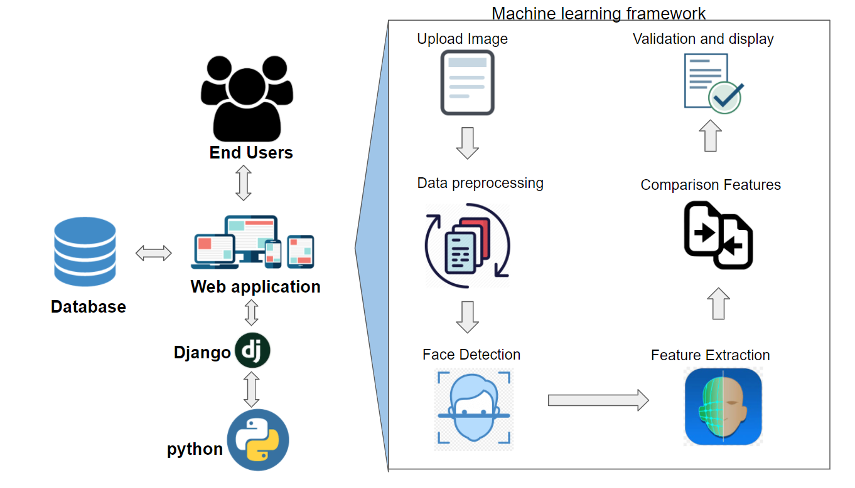
Overall Framework

Slide 10
Methodologies and models
Face detection
Face_recognition
HaarCascade
MTCNN
Viola-Jones
Feature Extraction
VGG16
VGG19
InceptionV3
Xception
Similarity
Manhattan distance
Euclidean distance

Slide 11







Tools and Techniques

Slide 12
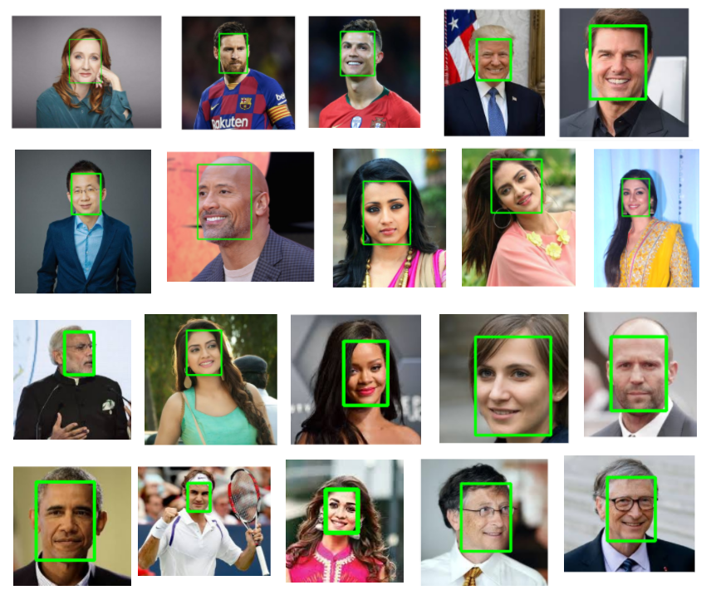
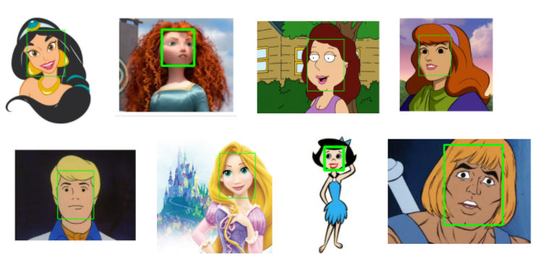
Results
Face detection
Results of MTCNN detect_faces for real and cartoon images

Slide 13
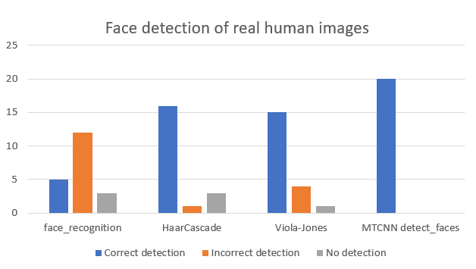
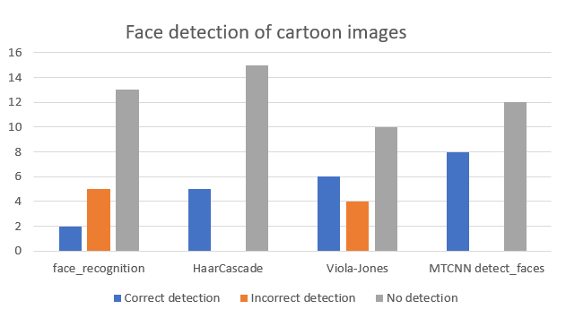
Results cont.
Face Detection

Slide 14
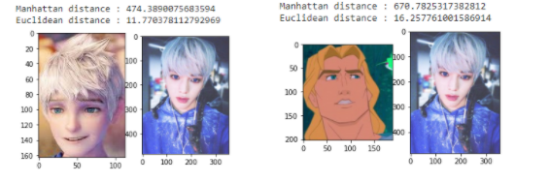
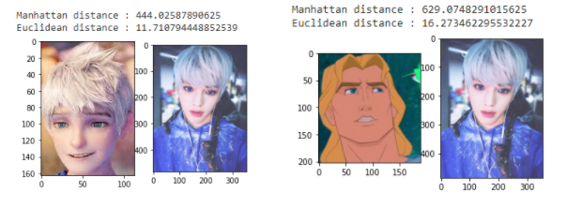
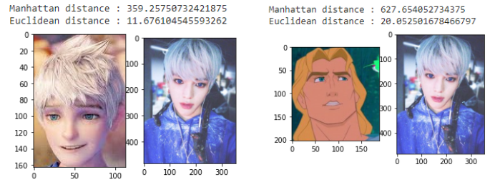
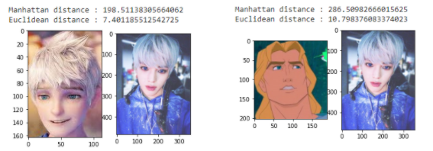
Results cont.
Face similarity
VGG16
VGG19
InceptionV3
Xception

Slide 15
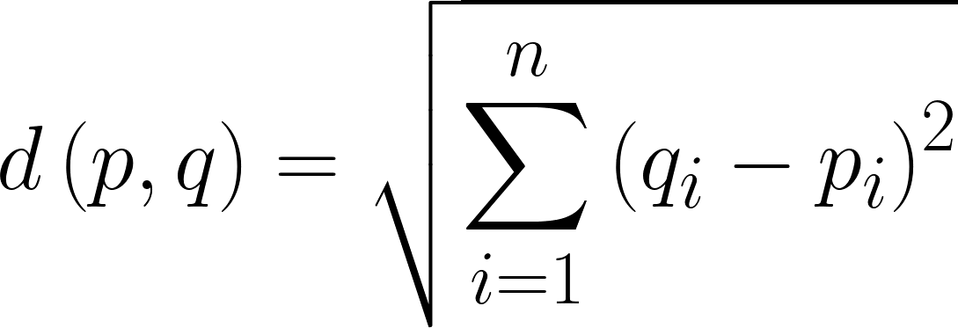
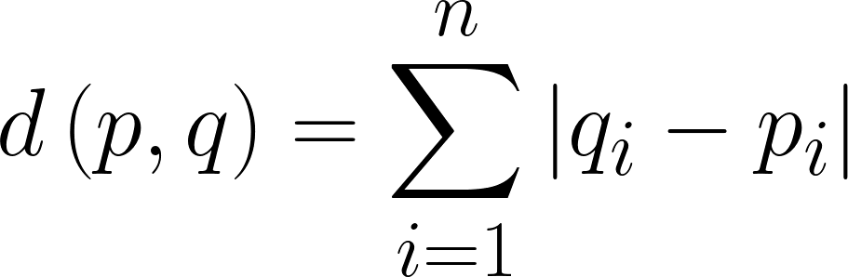
Results cont.
Face similarity
Calculations
Euclidean distance
Manhattan distance
VGG16 & VGG19
Feature vector - (1,4096)
Inception & Xception
Feature vector - (1,2048)
Notes:
Oya ehnm oya slide eka hadanwneh….ha

Slide 16

Conclusions
Low performance on face detection of cartoon characters
Image repository with only cartoon faces
MTCNN detect_faces model for face detection of human images
More try on feature extraction models for best accuracy & performance

Slide 17
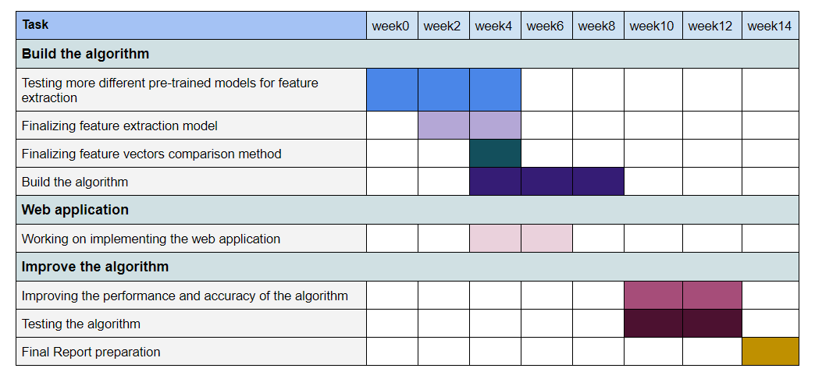
Gantt Chart (Phase 2)
Notes:
Hri neh
Hri ehnm

Slide 18

Future Works
Building cartoon face detection model from scratch
Considering the whole body in comparison

Slide 19

Demonstration

Slide 20

Thank You...

Slide 21


